Slide 1
Toll Optimization Algorithm for Evaluating Road Pricing Scenarios: Application to SacSim
Albab Noor, Joel Freedman, Mark Bradley (RSG)
Kyle Shipley, Yanmei Ou, Bruce Griesenbeck (SACOG)
June 4, 2019

Slide 2
Road Pricing
Manage Congestion
Generate Revenue

Slide 3
Network Coding
Travel time (Toll lane)
HIGH OCCUPANCY TOLL (HOT) LANE
TOLLID = 1
GENERAL PURPOSE LANES
GPID = 1
Travel time (GP lane)
Time Savings = Travel time (Toll lane) - Travel time (GP lane)

Slide 4
Algorithm
Start
Toll
NO
NO
YES
Toll Change < Conv. Criteria
Toll Change < Conv. Criteria
YES
Highway Assignment
YES
V/C > MAX V/C
NO
New Toll = Current Toll * Increment Factor
New Toll = Value of Time * Time Savings
End

Slide 5
Toll Optimization Loops in AM Peak Period 3 (9 AM – 10 AM)
 | Segment | HOT Time | GP Time | Time Savings | VOT Toll | Max V/C |  | DA | S2 | S3 | CV
Loop 1 | 1 | 3.21 | 3.33 | 0.12 | 0.04 | 0.79 |  | 0.11 | 0 | 0 | 0.16
 | 2 | 3.33 | 3.56 | 0.24 | 0.07 | 0.69 |  | 0.11 | 0 | 0 | 0.16
 | 3 | 4.78 | 6.07 | 1.29 | 0.38 | 0.79 |  | 0.61 | 0 | 0 | 0.92
 | 4 | 4.09 | 4.24 | 0.15 | 0.04 | 0.76 |  | 0.11 | 0 | 0 | 0.16
Loop 2 | 1 | 3.2 | 3.35 | 0.15 | 0.04 | 0.79 |  | 0.11 | 0 | 0 | 0.16
 | 2 | 3.33 | 3.56 | 0.24 | 0.07 | 0.7 |  | 0.11 | 0 | 0 | 0.16
 | 3 | 4.9 | 5.85 | 0.95 | 0.28 | 0.85 |  | 0.92 | 0 | 0 | 1.37
 | 4 | 4.07 | 4.25 | 0.18 | 0.05 | 0.74 |  | 0.11 | 0 | 0 | 0.16

Slide 6
Volume after Loop 5 in AM Peak Period 3 (9 AM – 10 AM)
 | Segments | DA | CV2 | CV3 | S2 | S3
Low VOT | 1 | 0 | 0 | 0 | 219 | 75
 | 2 | 0 | 0 | 0 | 145 | 49
 | 3 | 0 | 0 | 0 | 257 | 89
 | 4 | 0 | 0 | 0 | 236 | 79
Med VOT | 1 | 33 | 5 | 1 | 346 | 149
 | 2 | 0 | 0 | 0 | 207 | 89
 | 3 | 24 | 4 | 1 | 348 | 152
 | 4 | 0 | 0 | 0 | 272 | 122
High VOT | 1 | 231 | 90 | 3 | 220 | 129
 | 2 | 281 | 277 | 17 | 106 | 65
 | 3 | 211 | 91 | 2 | 207 | 126
 | 4 | 210 | 232 | 1 | 141 | 90

Slide 7
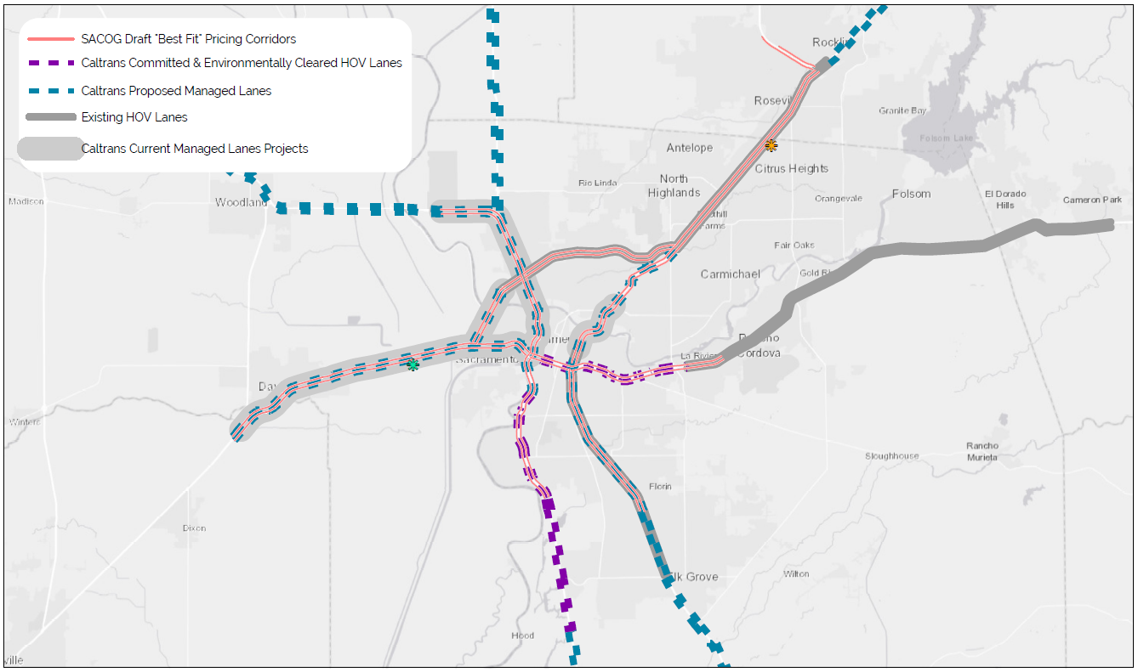
Application: Scenarios 2035

Slide 8
Range of Results for Pricing Tests

Slide 9
Conclusion
Enhancements made to the model allow the user to evaluate different road pricing scenarios
The user has control over which sections of which roadway to toll, set the initial, minimum, and maximum tolls for each segment
The user can estimate revenues and time savings that can be generated from different pricing scenarios
Disaggregate results from the ABM can be used for cost-benefit/equity analyses.

Slide 10
ALBAB NOOR
ANALYST
albab.noor@rsginc.com
KYLE SHIPLEY
ANALYST (SACOG)
kshipley@sacog.org

